Slide 1
Blender Notes
Sparks Lu
Laste updated: 7/15/2022

Slide 2
References
https://renderguide.com/category/blender-tutorials/

Slide 3
Usage

Slide 4
Install
apt
sudo add-apt-repository ppa:thomas-schiex/blender
sudo apt update
sudo apt install blender
snap
sudo apt install snapd && sudo snap install blender –classic
download
https://download.blender.org/release/
OpenGL
glxinfo
glxgears
Blender versions
2.79 can run on CPU

Slide 5
Shortcuts
Key | Function | Note
Tab | switch between edit and object mode
Mouse middle button | rotate view
Shift + mouse middle button | pan view
mouse view | zoom in/out
~ | Show view menu, switch view quickly between top/bottom/back/front/left/right/camera/selected
Alt + mouse middle button | Switch quickly between top/bottom/back/front/left/right
Ctrl+Alt+Q | 切换到四视角视图
Ctrl+空格 | 切换当前窗口是否最大化
Ctrl+Alt+空格 | 切换当前窗口全屏
, | Toggle orientation between global, view, local, cursor, normal, gimbal
. | Toggle pivot point between median point, bounding box center, ...
z | Toggle shading mode between wireframe, solid, material preview, rendered.
Shift + s | Snapping pie menu
Space | Search
Numpad 0 | Toggle camera view
Numpad 1~9 | Switch view among top/left/right/bottom. Or rotate view point around an axis. 1: front, 3: right, 7: top
F12 | Render
Shift + A | Open “Add” menu
N | Open/close property window
T | Show/hide Tools panel

Slide 6
Shortcuts in Edit Mode
Key | Function | Note
A | select or deselect all
B | border (rectangle) select
C | circle select | Esc to exit this mode
S | Scale selected
G | Move selected
R | Rotate selected
X | Delete selected
Ctrl+j | Join selected meshes
U | Show unwrap menu
Ctrl+e | Show edge menu
Shift+Alt+Right click | Select edge loop

Slide 7
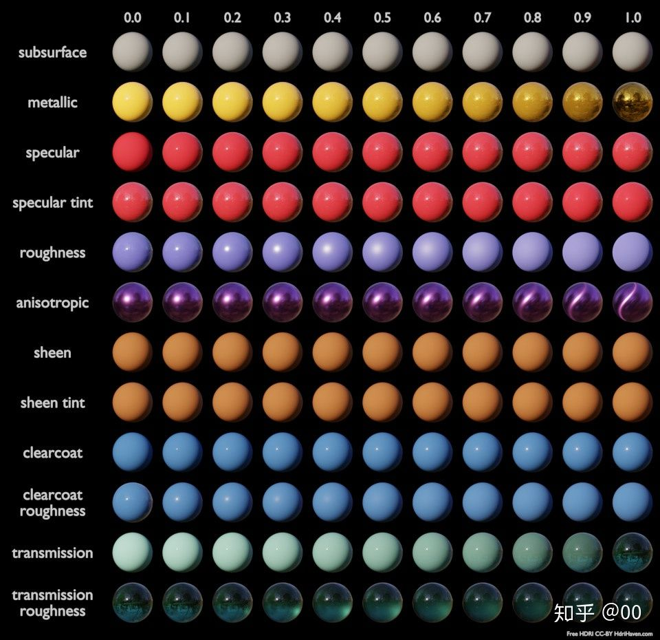
Materials

Slide 8
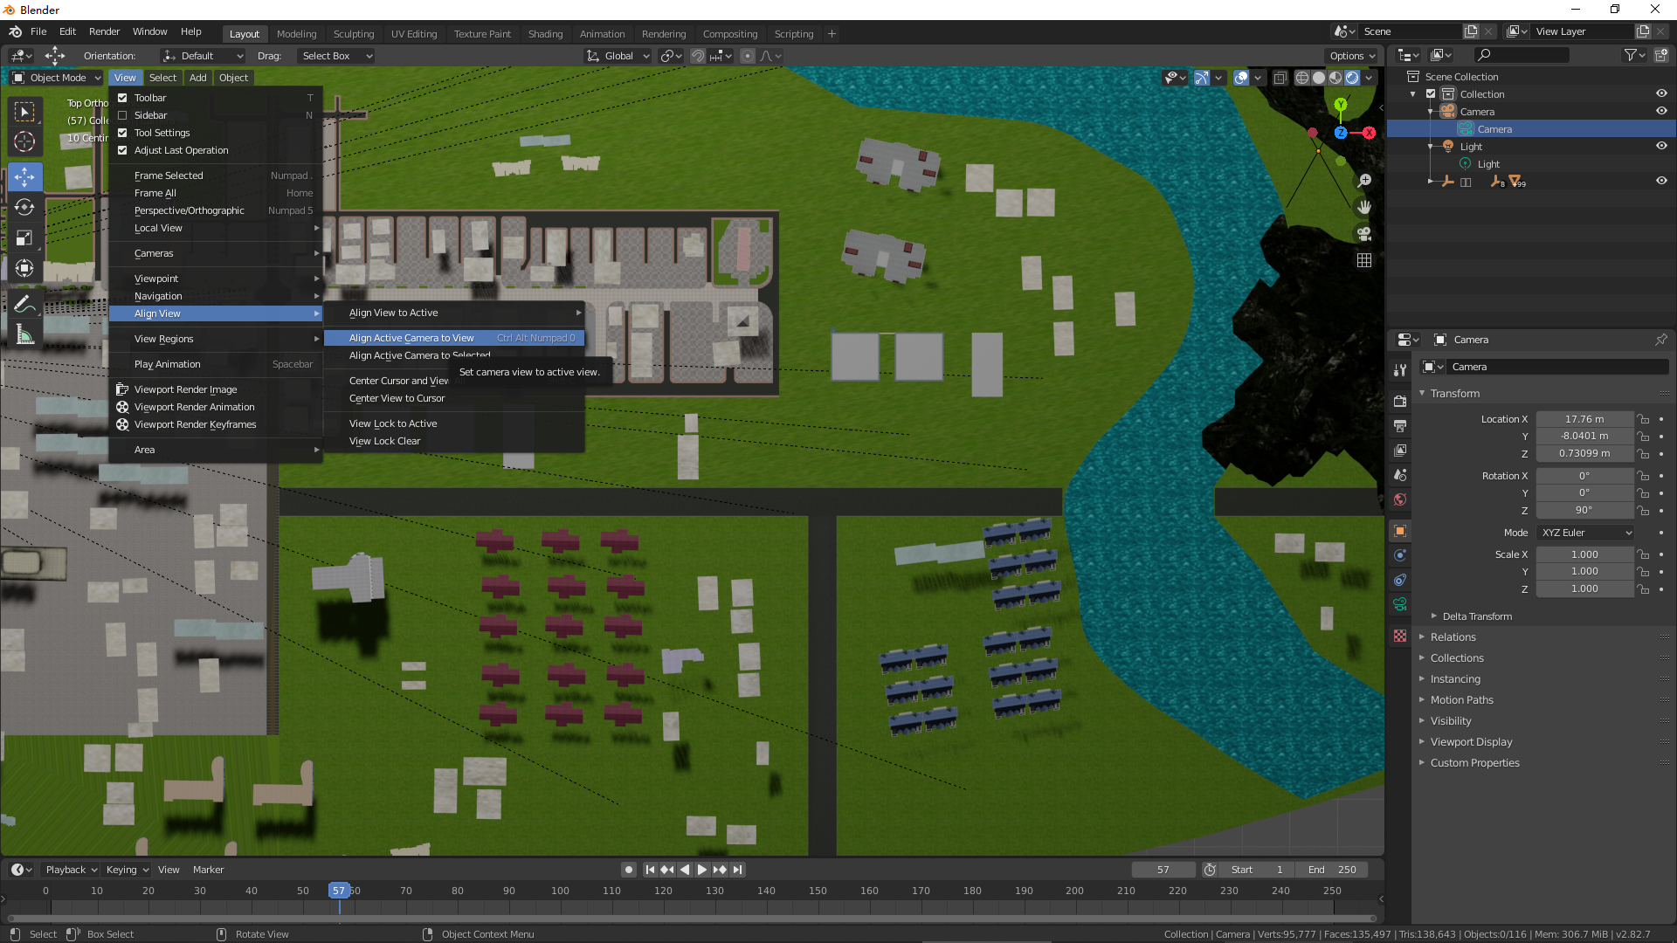
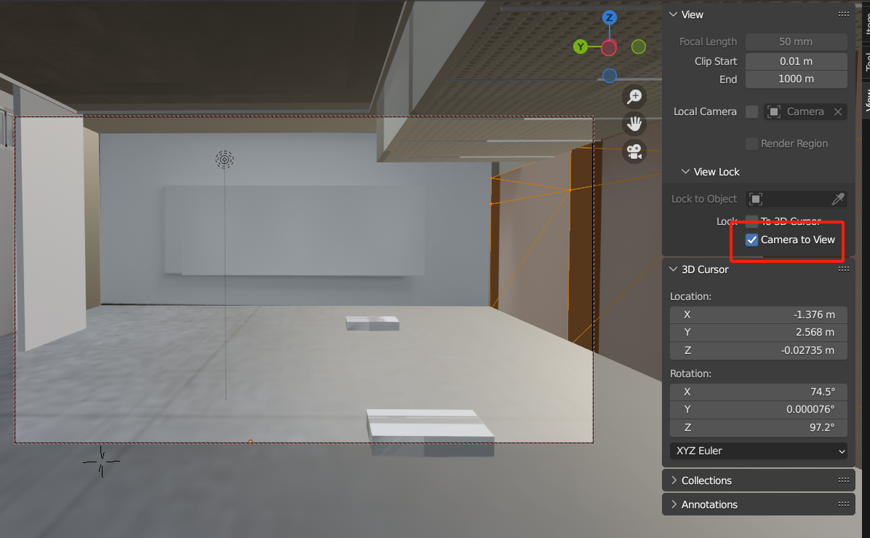
View
Align active camera to view
View -> Align View -> Align active camera to view
Lock camera to view
press n to show property pane
check “Camera to View”
adjust view, camera view will change accordingly

Slide 9
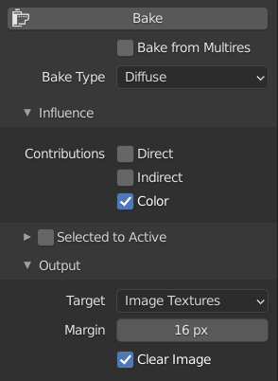
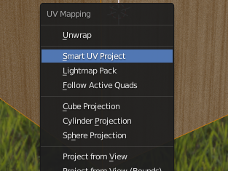
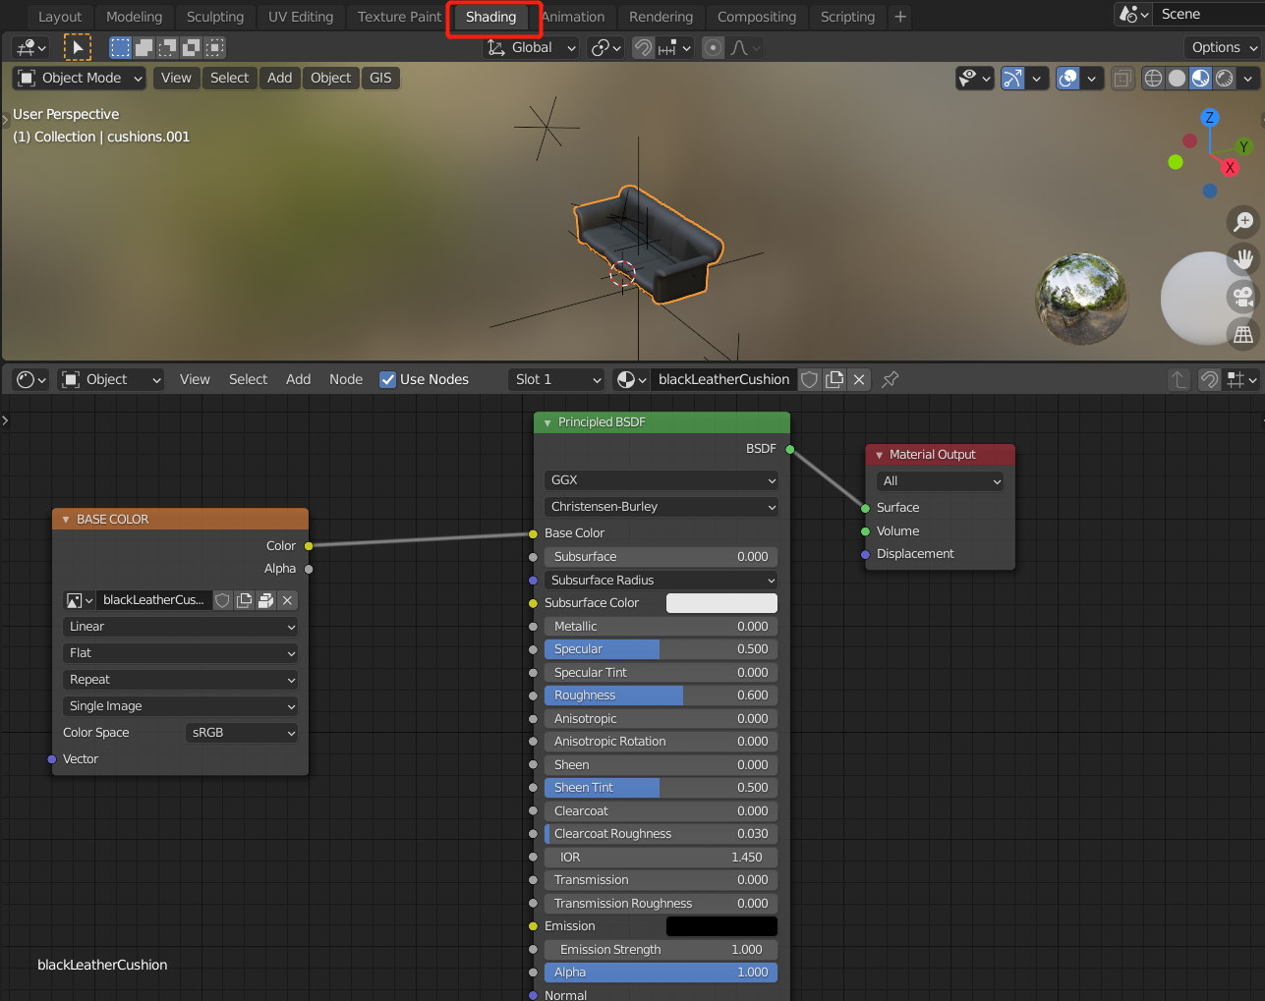
Bake Textures
References
https://blenderhub.net/blender-bake-texture-maps/
https://artisticrender.com/how-to-bake-textures-in-blender/
Steps
select objects to be baked
open “object data properties” (green triangle)
go to UV map section
create a new UV map named “baked”, select it
press “tab” to edit mode
press “a” to select all
press “u” to show “UV mapping” menu, select “Smart UV Project”
open “Render properties” (camera), change “Render Engine” to “Cycles”
open image editor, create a new image named with “baked”, save the image
switch to “Shading” workspace, in “Shader” editor
select “Add”->”Texture”->”Image Texture”
in the new image texture node, select the image created “baked”
select the new Image Texture node
open “Render properties”, go to “Bake” settings
select “Diffuse” bake type
In “Outline”, select the model to be re-baked.
click “Bake” button
after finish, in image editor, click “Image”->”Save”
connect new image with “Base Color” of “Principled BSDF”
switch to “Layout” workspace, apply new UI map
in “object data properties”, activate “baked” UV map, remove default “UVMap” (affect exported gltf)
switch back to “Object” mode

Slide 10
Bake One Material From Multiple Materials
Create new UV map as “baked”
Open “UV/Image Editor”
Create new image as “baked”
Switch to edit mode and select all
Press 'u' to show “UV mapping” menu
Select “Smart UV Project”
In “Data Object” panel, select “baked” UV map.
In Render panel, “Bake” pane
Set “Bake Mode” to “Textures”
Press “Bake”
After baking, in “UV/Image Editor”
Save image as “baked-4096.png”
In “Material” panel, add new material as “baked” and select it
In “Texture” panel, add new texture, select “baked-4096.png”
Assign “baked” material to object

Slide 11
Combine Multiple Objects into One
Press 'B' for box selection
Select all objects to be combined
Press Ctrl+j to combine selected objects

Slide 12
Texture Paint Mode
References
https://docs.blender.org/manual/en/latest/sculpt_paint/texture_paint/introduction.html
Steps

Slide 13
UV Unwrap
Target
Open all closed shapes
Smart UV Project
'Tab': Switch to edit mode
'u': Show UV menu
Select 'Smart UV Project'
Manual UV Unwrap
'Tab': Switch to edit mode
'a': Select none
Switch to edge select
Select edges
'Ctrl-E': edge menu
Select 'Mark Seam'
'a': Select all
'u': Show UV menu
Select 'Unwrap'
check the created UV map

Slide 14
Separate Model
Separate
3D viewport
press Tab to enter “Edit Mode”
turn on “Toggle X-Ray” in top-right corner of the viewport
switch to “Face Select”in the top-left corner of the viewport
box select the faces to be separated
press “p”, select “Separate”
as the result, selected faces will be separated into a new model
Use Knife tool
3D viewport
press Tab to enter “Edit Mode”
press “k”
Bisect
3D viewport
press Tab to enter “Edit Mode”
select “Bisect” tool
press “a” to select all
check “Clear Inner” or “Clear Outer”
click and drag
Separate
switch to “Edit“ mode
select “Mesh”->”Separate” menu item
selection
by material
by loose parts
Creates one object for every independent (disconnected) fragment of the original mesh.

Slide 15
Join Model
Steps
Press Shift to select multiple objects in normal mode
Select “Object” menu -> “Join” menu item
Result: object will have multiple materials if not the same

Slide 16
Fill Hole
Steps
Press “Tab” to switch to edit mode
Swith to select “edges”
Select edges around the hole
Select “Mesh” menu -> “merge” menu item -> “at center” menu items
Result: edges will be merged at center of the edges

Slide 17
Align Vertices or Edges
Steps
Select vertices or edges
Press “s” key
Press “z” key
Press “0” key
As the result, in z direction, all selected vertices or edges are aligned.

Slide 18
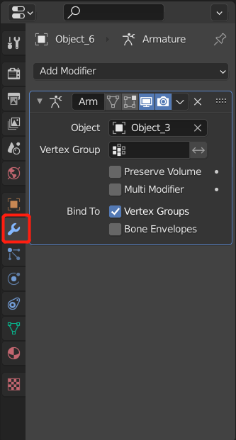
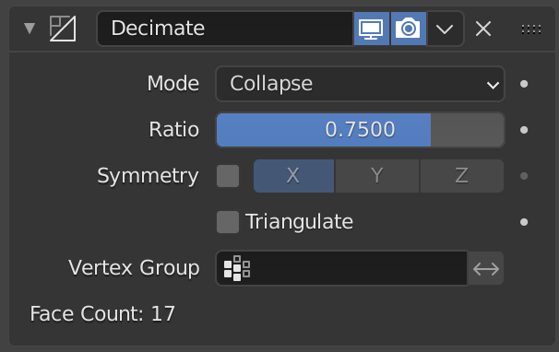
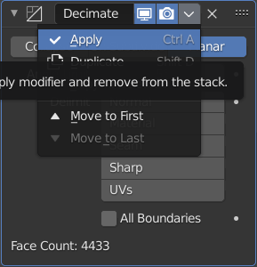
Decimate Model
References
https://all3dp.com/2/blender-simplify-mesh-simply-explained/
Steps
Import model
Select model
Switch to “modifier” tab, select “Decimate” modifier
Change “Ratio” to decimate model
100K faces -> 10K faces
Select “Apply”
Export model
Scale down texture accordingly

Slide 19
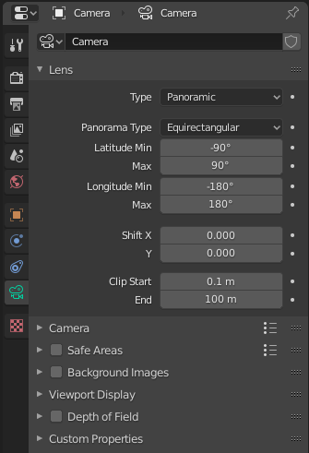
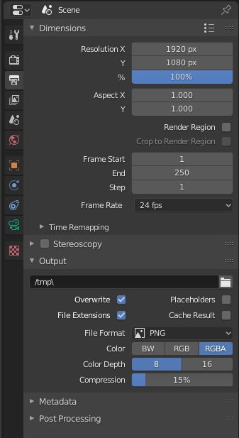
Panorama
Operations
Select “Cycles Render” (v2.79)
Select camera object
Open “Object Data Properties” panel
Select “Panoramic” in Lens
Select “Render Image” item from “Render” menu

Slide 20
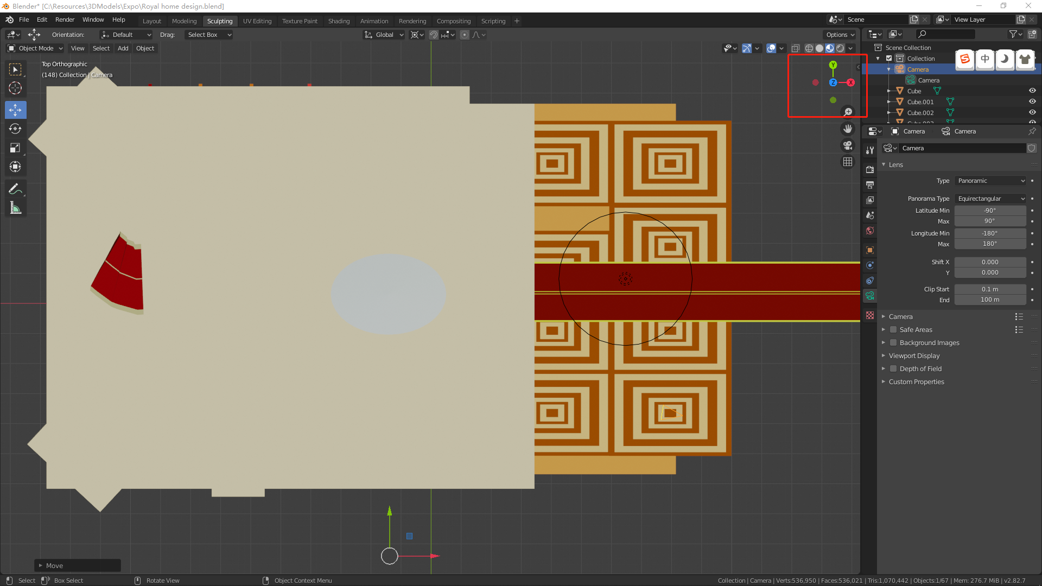
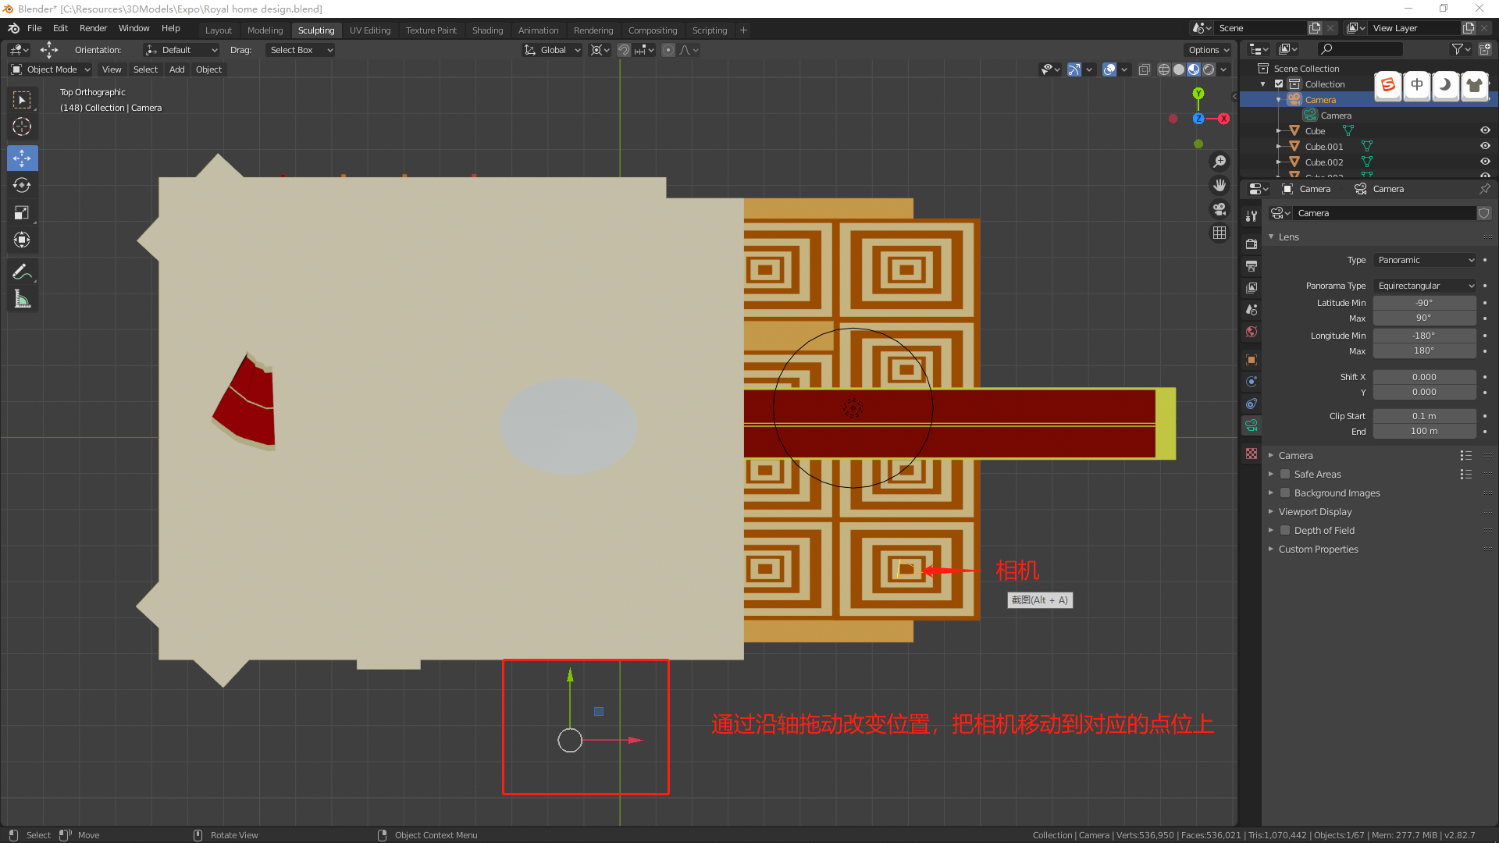
3D To Panorama

Slide 21
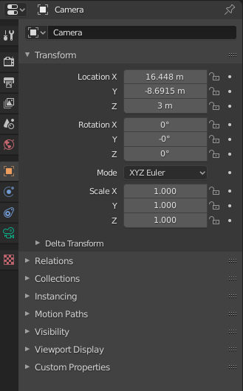
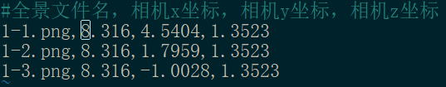
Set Camera
Click Z axis to switch to top view
Align active camera to view
View -> Align View -> Align active camera to view
Record camera position

Slide 22
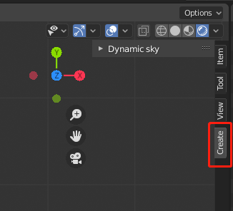
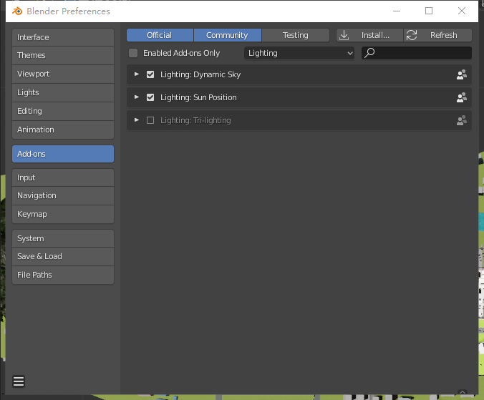
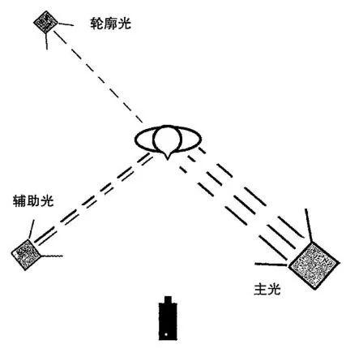
Lighting
Dynamic Sky
Check Preferences -> Add-ons -> Lighting -> “Dynamic Sky”
“3D Viewport” -> Sidebar -> “Create” tab, press “Create”
In “World Properties” tab, select “Dynamic_1” instead of default “World”
Sun-Position Add-On
Check Preferences -> Add-ons -> Lighting -> Sun Position
In “World Properties” tab, “Sun Positions” panel
Three-Point Lighting Setup
Key light: strongest
Side light: weak, on the side of key light
Back light: weaker, on the opposite of key light

Slide 23
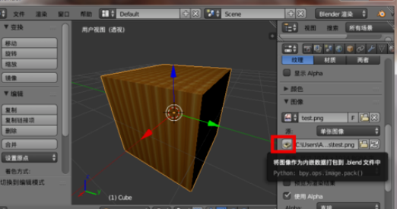
Texture Embedding
Steps

Slide 24
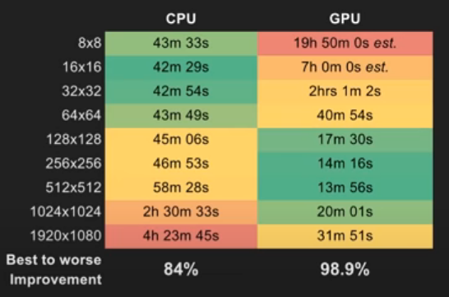
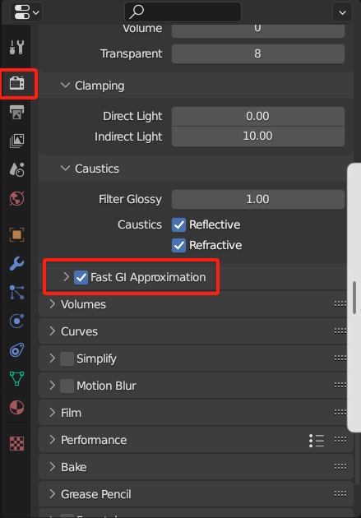
Rendering
GPU rendering
Preferences->System->Cycle Render Devices
Select CUDA
Scene
Properties->Render->Device
Improve speed
Refert to https://www.youtube.com/watch?v=8gSyEpt4-60
Reduce light bounces (Render->Light Paths)
Use portal
GPU Rendering
Change tile size
Reduce samples
Disable caustics
Remove alpha transparency
Remove volumetrics (e.g. fog)
Render Engine
Cycles
Render->LIght Paths->Check “Fast GI Approximation”
Eevee

Slide 25
Command Line Mode
Params | Meaning | Note
-a | render animation
-b | run in background
--debug-all | verbose debug output
-o (--render-output) <path> | render output
--scene <name> | set active scene for render
-t (--threads) <threads> | use defined threads

Slide 26
FAQ
Pink in the rendering result
texture file missing
FBX imported with absolute path
It may result in texture file missing
File->External Data->Find Missing Files
Load models in runtime
https://github.com/KhronosGroup/UnityGLTF

Slide 27
Add-Ons

Slide 28
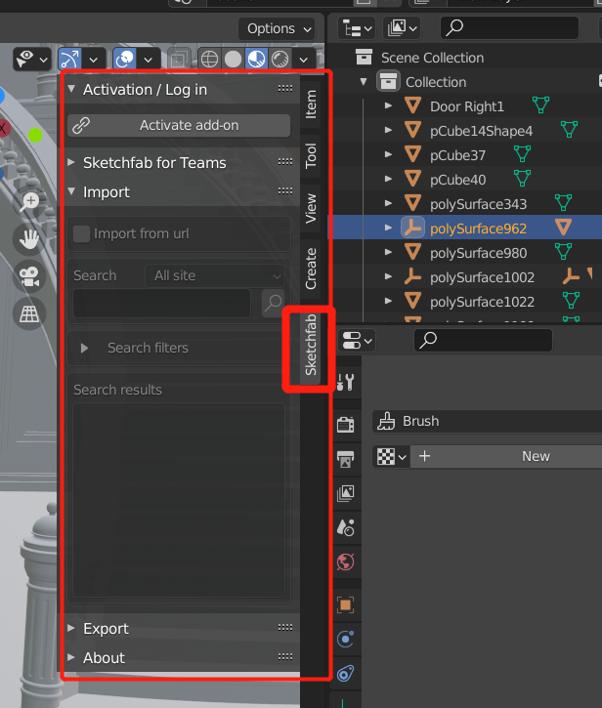
Sketchfab
References
https://github.com/sketchfab/blender-plugin
Install
Download zip
Preferences -> Add-ons -> Install from file
“Sketchfab” tab in “Properties” (N)
Login to sketchfab
Functions
Import
Export

Slide 29
SimpleBake
References
https://blendermarket.com/products/simplebake---simple-pbr-and-other-baking-in-blender-2

Slide 30
Dynamic Sky
Reference
https://docs.blender.org/manual/en/latest/addons/lighting/dynamic_sky.html
Usage
Preferences->Add-ons->Lighting, Check “Dynamic Sky”
3D Viewport -> Sidebar -> Create tab, press “Create”
Properties -> World, choose “Dynamic_1”

Slide 31
Modifiers
Solidify
Add thickness to faces
Bevel
Add bevel effects to mesh
Array
Create an array of meshes

Slide 32
Python Dev

Slide 33
Introduction
Reference
https://docs.blender.org/api/current/index.html
https://github.com/HusseinBakri/BlenderPythonDecimator
How to run
Text editor
Python console
Basic
import bpy
Data
bpy.data.
objects, scenes, materials
Install python module
Ubuntu 18.04
conda create -n py3.8 python=3.8
conda activate py3.8
# conda install -c kitsune.one python-blender=2.83 (not exist any more)
# conda install -c jewfrocuban python-blender=2.80 (<=py3.7)
Versions
blender 2.91/2.92 <-> python 3.7

Slide 34
Modules
Freestyle
GPU Shader
GPU Utilities
ID Property
Image Buffer
Audio
OpenGL Wrapper
Math
Font Drawing
BMesh
MessageBus
Utilities
Path Utilities
Application Data
Property Definition
Context
Operators
Data
Types

Slide 35
Modules
bpy.aud
bpy.bgl
bpy.bl_math
bpy.bl_math
bpy.blf
bpy.ops
bpy.path
bpy.app
bpy.props
bpy.context
bpy.data
bpy.msgbus
bpy.types
bpy.utils

Slide 36
Build Blender As Python Module
Reference
https://wiki.blender.org/wiki/Building_Blender/Other/BlenderAsPyModule#:~:text=%20Building%20Blender%20as%20a%20Python%20Module%20,install%20the%20Python3.x-framework%20from%20Python.org.%20%20More%20
https://wiki.blender.org/wiki/Building_Blender/Linux/Ubuntu
Steps
mkdir blender_git
git clone https://github.com.cnpmjs.org/blender/blender.git
sudo apt-get install build-essential git subversion cmake libx11-dev libxxf86vm-dev libxcursor-dev libxi-dev libxrandr-dev libxinerama-dev libglew-dev
Install dependencies
./blender/build_files/build_environment/install_deps.sh // fail
mkdir lib (lib should be in same folder with blender)
svn checkout https://svn.blender.org/svnroot/bf-blender/trunk/lib/linux_centos7_x86_64
modify /etc/ld.so.conf.d/ && sudo ldconfig
Install gcc 9.3
sudo add-apt-repository ppa:ubuntu-toolchain-r/test
sudo apt update
sudo apt install gcc-9
cd blender && make update && make bpy

Slide 37
Context
scene
render
layers
image_settings
file_format, color_depth, file_format
resolution_x
resolution_y
resolution_percentage
alpha_mode
objects
object
modifiers['EdgeSplit']

Slide 38
Ops (bpy.ops)
load project file
bpy.ops.wm.open_mainfile(filepath="file_path")
import_scene
obj
object
mode_set(mode='EDIT')
mode_set(mode='OBJECT')
modifier_add(type='EDGE_SPLIT')
modifier_apply()
lamp_add()
mesh
remove_doubles()
render
render(write_still=True)

Slide 39
Camera
camera = scene.camera
camera.data
camera.location
camera.constraints

Slide 40
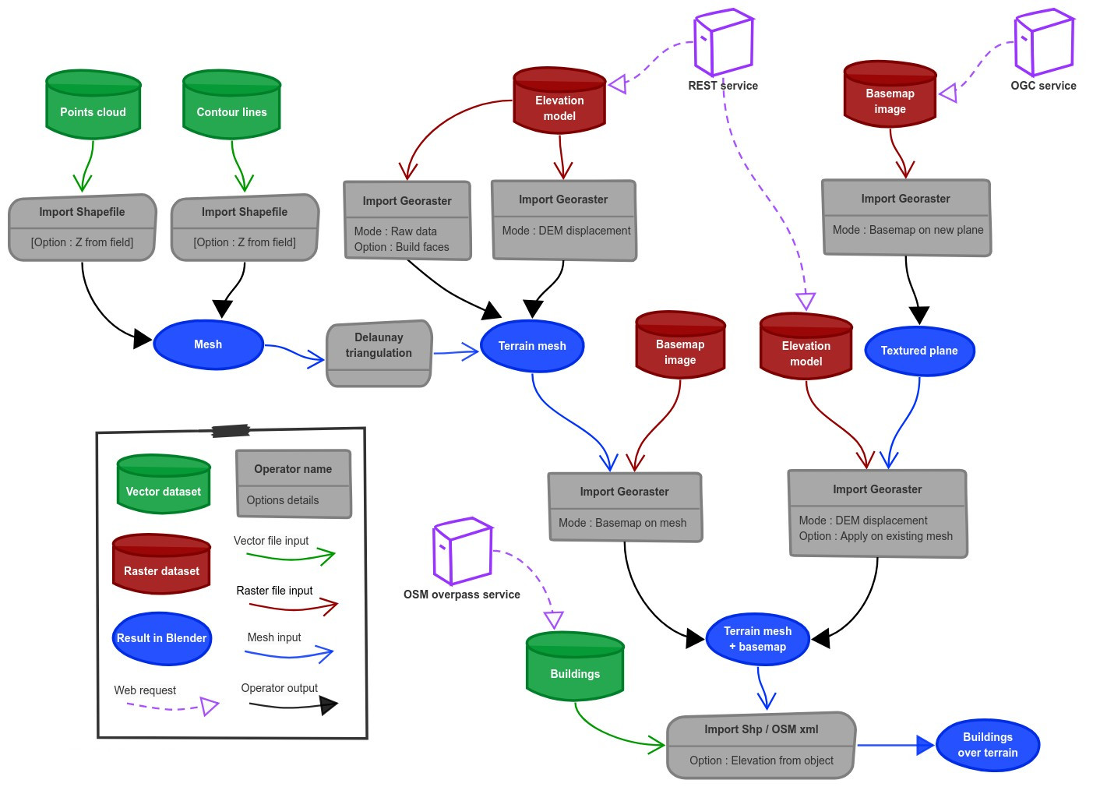
Blender-GIS
Refer
https://github.com/domlysz/BlenderGIS
https://www.bilibili.com/video/BV1bE411q7rM/?spm_id_from=333.788.recommend_more_video.1
Steps
GIS->Web Geodata->Basemap
Source: Google, Layer: satellite
Press “G” to search for a place
Press “E” to export a raster image
Select exported image
GIS->Web Geodata->Get SRTM

